Slide 1


ENERGY USAGE OPTIMIZATION FOR A MANUFACTURING PLANT
Presented By : G THIRUMALA VASU

Slide 2
Contents
Business Objective
Business Constraints
Project Architecture - Data Flow Diagram
Data Collection
Exploratory Data Analysis
Data Visualization
Notes:
Change

Slide 3
Business Problem
Problem Statement:
High energy costs due to inefficiencies in plant operations.
Business Objective :
Minimize energy consumption while maintaining production levels.
Business Constraints:
Ensure energy usage does not compromise output quality.

Slide 4
Project Overview and Scope
This project focuses on addressing high energy costs within a manufacturing plant by identifying and eliminating inefficiencies in plant operations. By leveraging advanced analytics and optimization techniques, the initiative aims to ensure energy consumption is minimized without compromising production levels or product quality. The goal is to align energy usage with operational requirements to achieve cost savings and support sustainable manufacturing practices.
Energy Consumption Analysis: Evaluate historical energy usage patterns across different production processes.
Inefficiency Identification: Pinpoint areas of energy wastage and operational inefficiencies within the plant.
Success Metrics: Ensure a 15% reduction in energy consumption and achieve annual cost savings of $1.2M

Slide 5
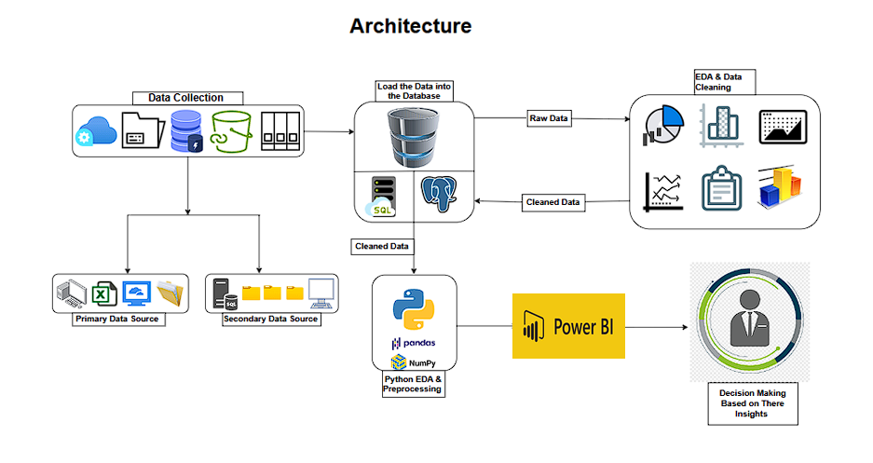
Project Architecture

Slide 6
Data Dictionary
Column Name | Description | Data Type | Scale of Measurement
Date | The date of the production process | Date | Interval
Shift | The work shift during which the data was recorded(eg.Morning,Afternoon,Night) | Object (Categorical) | Nominal
Furnance_ID | Unique identifier for the furnance used | Object (Categorical) | Nominal
Furnance_Type | Type of furnance used (eg. Electric, Gas, or other categories). | Object (Categorical) | Nominal
Batch_Type | Type of batch processed (eg. Raw, Recycled, or Special mixes). | Object (Categorical) | Nominal
Production Output(tons) | Amount of glass produced during the process, measured in tones. | Float (Numeric) | Ratio
Energy_Consumption(kwh) | Energy consumed by the furnance during the process, measured in kilowatt-hours. | Float (Numeric) | Ratio
Furnance_Temperature | The operating temperature of the furnance during the process measured in degree celsius. | Float (Numeric) | Interval
Annealing_Time(hrs) | Time spent in annealing, measured in hours | Float (Numeric) | Ratio
Downtime(hrs) | Hours of non-production ordowntime during the shift | Float (Numeric) | Ratio
Ambient_Temperatures | External or surrounding temperatiureduring the process, measured in degree celsius. | Float (Numeric) | Interval
Recycled_Content(%) | Percentage of recycled material used in the glass production batch. | Float (Numeric) | Ratio
Energy_Rating | Rating of the furnance energy efficiency, typically on a predefined scale (eg. A,B,C). | Object (Catregorical) | Ordinal
Maintance_Flag | Indicator of Whether maintenance was performed during the shift (eg. Yes/No or Binary). | Binary | Nominal
Fuel_Type | Type of fuel used in the furnance( eg. Gas, Electric, Coal). | Object (Catregorical) | Nominal
Glass_Thickness(mm) | Thickness of the glass produced, measured in millimeters. | Float (Numeric) | Ratio
Production_Targets(tons) | Target Production output for the shift, measured in tons. | Float (Numeric) | Ratio
Defects_Percentage(%) | Percentage of the glass produced with defects during the process. | Float (Numeric) | Ratio
Melting_Time(hrs) | Time taken to melt raw materials, measiured in hours. | Float (Numeric) | Ratio
Cooling_Energy(kwh) | Energy consumed during the cooling process, measured in kilowatt-hours. | Float (Numeric) | Ratio

Slide 7
Exploratory Data Analysis [EDA]
Statistical Insights
Business Insights
Operational Highlights:
Majority operations during the morning shift with Furnace_6 as the most used.
Electric furnaces dominate; batch type is Borosilicate.
Production and Energy:
Average production output: 108.9 tons (low variability).
Energy consumption: 2804.95 kWh (high variability, needs optimization).
Process Metrics:
Furnace temperature: 1549.25°C (stable).
Melting time: 16.14 hours (moderate variability).
Quality and Maintenance:
Defects: 5.55% (high fluctuation, requires focus).
Downtime averages 2.53 hours, with regular maintenance.
Recycling and Environment:
Recycled content: 39.67% (high variance).
Ambient conditions remain consistent at 27.4°C.
Operational Focus: Optimize morning shift operations, staffing, and energy usage for peak efficiency.
Equipment: Prioritize maintenance and optimization of Furnace_6 to reduce downtime and improve performance.
Production: Stabilize output to align with targets, focusing on borosilicate batches for specialized process improvement.
Energy Efficiency: Address fluctuations in energy and cooling consumption to achieve cost savings and upgrade energy efficiency from "B" to "A."
Quality: Improve defect rates and standardize recycling practices for better yields and sustainability.
Downtime: Reduce average downtime of 2.5 hours with predictive maintenance.
Notes:
EDA is used for seeing what the data can tell us before the modeling task.
Change

Slide 8
Data Preprocessing
1.Type Casting
Ensured consistent data types (e.g., converting numerical columns to float/int and categorical columns to string).
Corrected mismatches to facilitate accurate analysis.
2. Checking for Duplicates
Identified and removed duplicate records to maintain data integrity.
3. Outlier Detection
Used statistical methods (e.g., Z-score, IQR) and visualizations (boxplots) to detect anomalies in numerical data.
4. Outlier Handling
Addressed outliers by capping, flooring, or removal to minimize their impact on analysis.
5. Encoding
Converted categorical variables into numerical form using:
Label encoding for ordinal data.
One-hot encoding for nominal data.
6. Handling Missing Values
Handled missing data using techniques like:
Mean/median imputation for numerical columns.
Mode imputation or "unknown" category for categorical columns.
Removal of rows/columns with excessive missing values.
Notes:
Keep observations

Slide 9
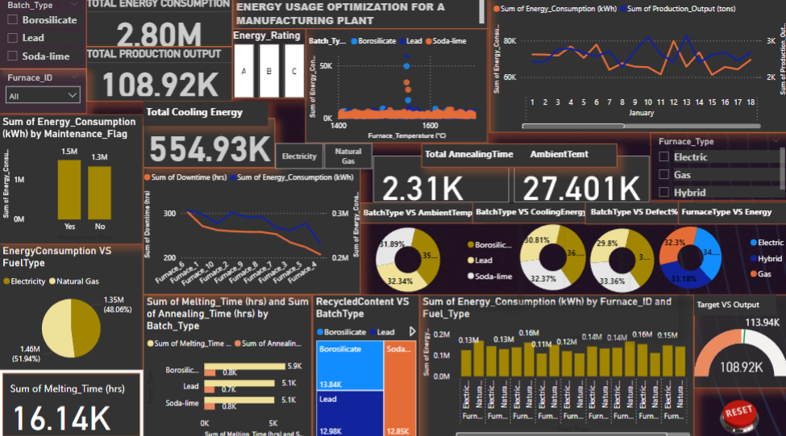
Data Visualization
Notes:
Add graphical

Slide 10


